Slide 1
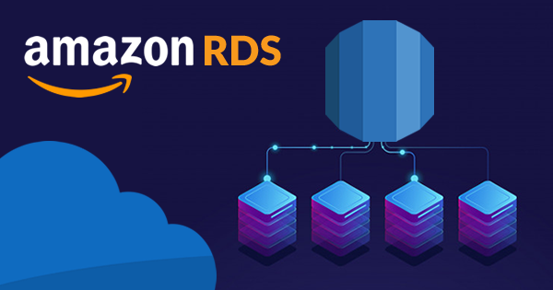
Back Ups, Multi-AZ & Read Replicas

Slide 2

Topics
RDS Backup
Automated Backups
DB Snapshots
Restoring Backups
Encryption At Restoring
What is Multi-AZ
What is Read Replicas
Exam Tips

Slide 3

RDS Backup
Amazon RDS creates and saves automated backups of your DB instance during the backup window of your DB instance. RDS creates a storage volume snapshot of your DB instance, backing up the entire DB instance and not just individual databases
Backups are stored in Amazon S3.
There are two different types of Backups for RDS:
Automated Backups
Database Snapshots

Slide 4

Automated Backups
Automated Backups allows you to recover your databases to any point in time within a "retention period". The retention period can be between one and 35 days.
Retention period: This policy refers to how long these backup tapes/media are kept (their retention).
Automated Backups will take a full daily snapshot and will also store transaction logs throughout the day.

Slide 5
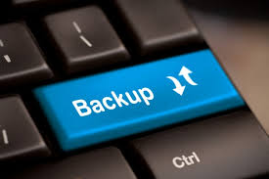
Automated Backups
When you do a recovery, AWS will first choose the most recent daily backup and then apply transaction logs relevant to that day.
This allow you to do a point in time recovery down to a second, within the retention period.
Automated Backups are enabled by default. The backup data is stored in S3 and you get free storage space equal to the size of your database. So, if you have an RDS instance if 10GB, you will get 10GB worth of storage.
Backups are taken within a define window. During the backup window, storage I/O may be suspended while your data is being backed up and you may experience elevated latency.

Slide 6

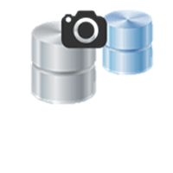
DB Snapshots
DB Snapshots are done manually (ie they are user initiated). They are stored even after you delete the original RDS instance, unlike automated backups.

Slide 7

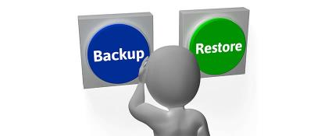
Restoring Backups
Whenever you restore either an Automatic Backups or a manual Snapshots, the restored version of database will be new RDS instance with a new DNS endpoint.
original.us-east-1.rds.amazonaws.com
restored.us-east-1.rds.amazonaws.com

Slide 8

Encryption At Restoring
Encryption at rest is supported for MySQL, Oracle, SQL Server, PostgreSQL, MariaDB & Aurora.
Encryption is done using the AWS Key Management Service (KMS) service.
Once your RDS instance is encrypted, the data stored at rest in the underlying storage is encrypted, as are its automated backups, read replicas and snapshot

Slide 9

What is Multi-AZ
Multi-AZ allows you to have an exact copy of your production database in another Availability Zone.
AWS handles the replication for you, so when your production database is written, write will automatically be synchronized to the stand-by database.
In the event of planned database maintenance, DB Instance failure, or an Availability Zone failure, Amazon RDS will automatically failover to the standby so that database operations can resume quickly without administrative intervention.
It is not primarily used for improving performance. For performance improvement, you need Read Replicas.
Multi-AZ is available for the following databases:
SQL Server, Oracle, MySQL Server
PostgreSQL, MariaDB

Slide 10


Multi-AZ
us-east-1a
us-east-1b

Slide 11
Multi-AZ
us-east-1a
us-east-1b

Slide 12
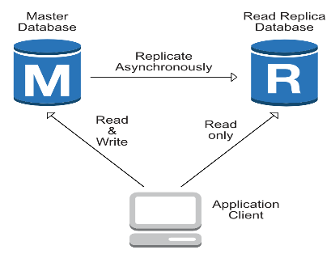
What is Read Replicas
Read replicas allow you to have a read-only copy of your production database.
This is achieved by using Asynchronous replication from the primarily RDS instance to the read replicas. You use read replicas primarily for very read-heavy database workloads
Read replicas is available for the following databases:
Oracle, MySQL Server
PostgreSQL, MariaDB, Aurora

Slide 13
Read Replicas
us-east-1c
us-east-1a
us-east-1b

Slide 14
Read Replicas

Slide 15
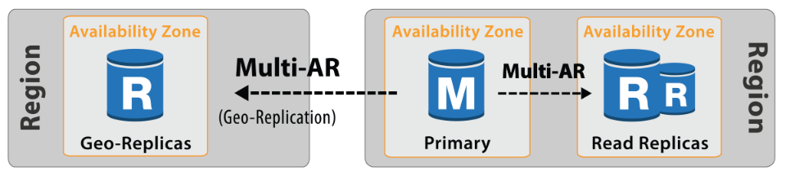
Read Replicas
Used for scaling, not for Disaster recovery
Must have automatic backups turned on in order to deploy a read replicas
You can have up to 5 read replica copies of any database
You can have read replica of read replica( but watch out for latency)
Each read replica will have its own DNS end point.
You can have read replicas that have Multi-AZ.
You can create read replicas of Multi-AZ source databases.
Read replicas can be promoted to be their own databases. This break the replication
You can have a read replica in a second region.

Slide 16

Exam Tips:
There are two different types of backups fir RDS:
Automated Backups
Database Snapshots
Read Replicas:
Can be Multi-AZ.
Used to increase Performance
Must have backups turned on
Can be in different regions
Can be MySQL, PostgreSQL, MariaDB, Oracle, Aurora
Can be promoted to master, this will break the Read Replicas

Slide 17
Exam Tips:
Multi-AZ
Used for DR
You can force a failover from one AZ to another by rebooting the RDS instance
Encryption at rest
Encryption at rest is supported for MySQL, Oracle, SQL Server, PostgreSQL, MariaDB & Aurora.
Encryption is done using the AWS Key Management Service (KMS) service, Once your RDS instance is encrypted, the data stored at rest in the underlying storage is encrypted, as are its automated backups, read replica and snapshots.

Slide 18
Thank you

